Slide 1



DIGISIM PART 1
EVM MACHINE BY TEAM SSS

Slide 2
BASIC IDEA APPROACH FEATURES DATASHEET
AGENDA

Slide 3
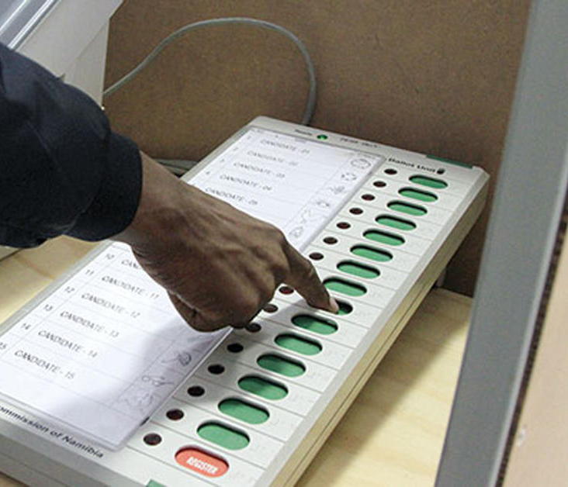
BASIC DESCRIPTION
WORKS LIKE AN EVM MACHINE
BALLOT VOTE INCREASES BY ONE ON CLICKING PUSH BUTTON
RED LED WHEN EVM IS OFF AND GREEN LED WHEN ON
COUNT BUTTON CALCULATES NUMBER OF VOTES OF WINNER
3 SECOND DISABLED ONCE BUTTON IS PRESSED
USER GIVEN A TOTAL VOTING TIME OF 15SEC
MACHINE STARTS WORKING 3 SEC AFTER SWITCHING ON

Slide 4
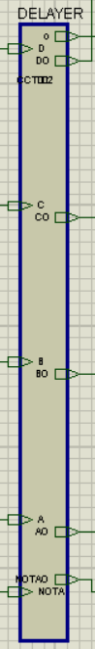
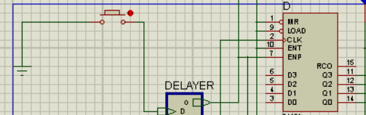
approach
CONNECTED COUNTERS TO GROUND VIA PUSH BUTTON WHICH WHEN PRESSED INCREASES COUNT BY ONE.
DELAYER CONSISTING OF COUNTER AND FF IS USED TO SWITCH OFF MACHINE.

Slide 5
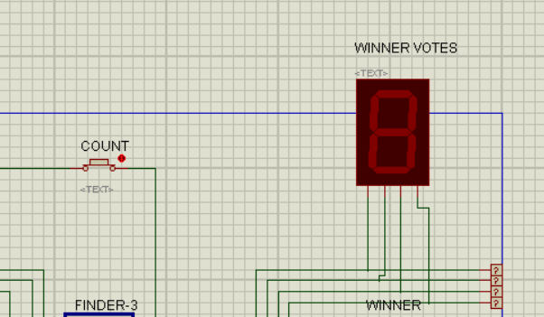
APPROACH
THEN VOTES CASTED ARE COMPARED BY FINDER AND FINALLY DISPLAYED WHEN COUNT BUTTON IS SWITCHED ON.

Slide 6
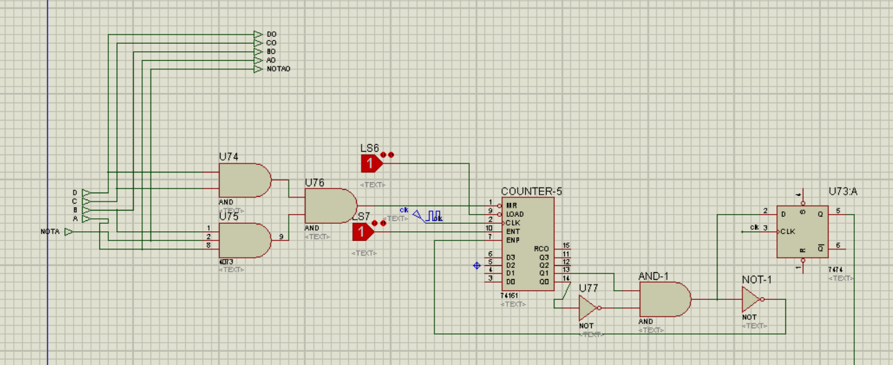
SPECIAL FEATURES
DELAYER
D,C,B,A AND NOTA ARE CONNECTED BY AND GATES SO THAT WHEN ANY ONE OF THEM IS 0(i.e., when button is pressed) THEN FINAL OUTCOME OF LAST AND GATE IS 0 WHICH RESETS THE COUNTER TO INITIAL STATE.

Slide 7
SPECIAL FEATURES
COUNTER STARTS FROM 0 AND GOES TILL TWO WHEN THE COUNTER STOPS DUE TO THE CONNECTION OF THE COMBINATIONAL CIRCUIT AFTER COUNTER TO ENP PIN.
D FF IS USED SO THAT THE ENP PIN OF THE COUNTERS CONNECTED TO BUTTONS WILL BECOME HIGH AFTER COMPLETE 3 SEC ONLY.

Slide 8
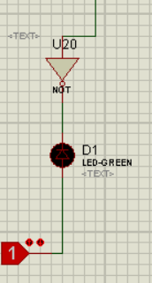
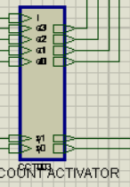
SPECIAL FEATURES
BLINKING LED
GREEN LED IS SWITCHED ON WHEN MACHINE IN ON STATE AND BLACK WHEN MACHINE IN OFF STATE.
COUNT ACTIVATOR
A SINGLE COUNT BUTTON WHEN CONNECTED TO ACTIVATOR AND SWITCHED ON CAN DISPLAY THE VOTES CASTED BY WINNER.

Slide 9
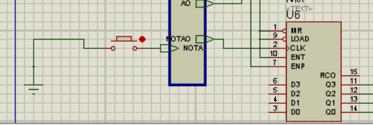
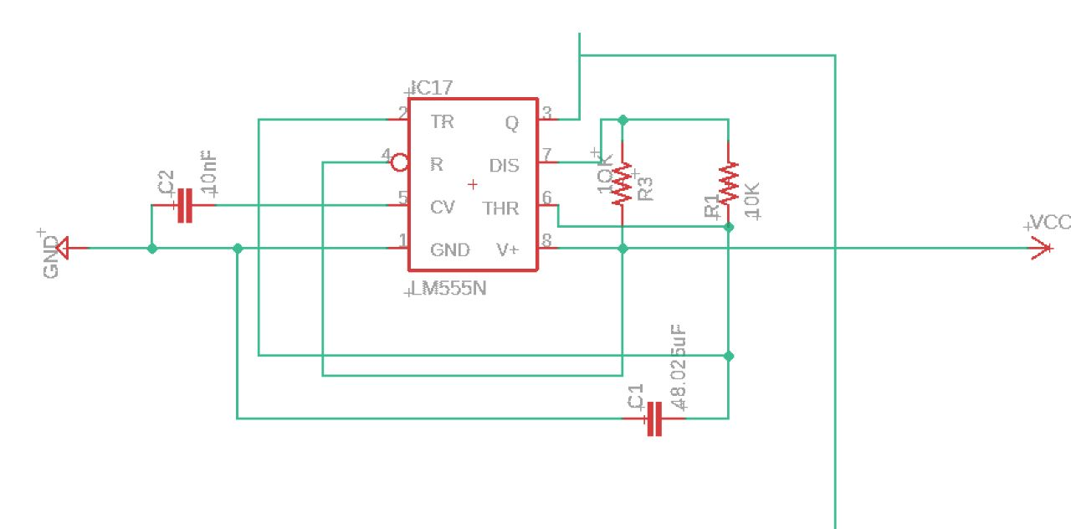
SPECIAL FEATURES
NOTA
NOTA IS PROVIDED IF VOTER DOES NOT WANT VOTE ANYONE AND ALSO NUMBER NOTA VOTES CAN ALSO ACCESSED USING A SEPARATE SWITCH FOR IT.
CLOCK
CLOCK DEVELOPED USING 555 TIMER IC AT A SPECIFIC RESISTANCE AND CAPACITANCE GIVING US THE REQUIRED FREQUENCY OF 1HZ ON EAGLE CAD.

Slide 10
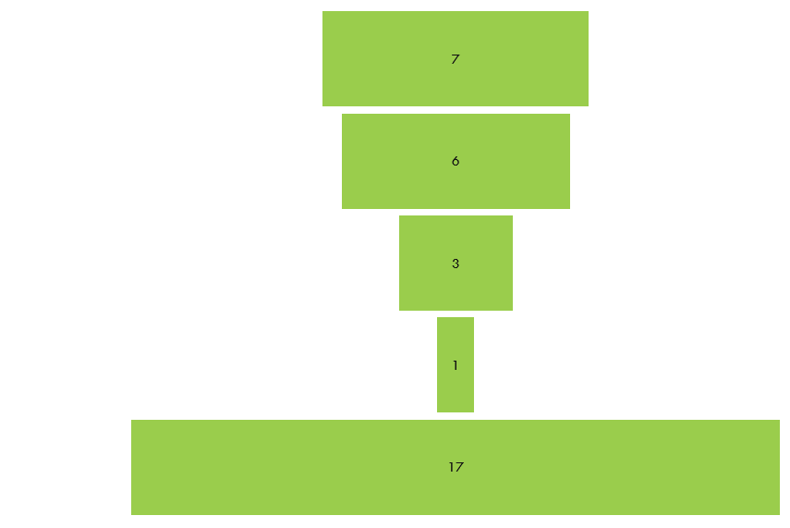
DATASHEET
COUNT

Slide 11
THANK YOU
-ANIRUDH AND SAHITH

